Slide 1
Wireless Triboelectric Nanogenerator
B. Sc. Martin schneider

Slide 2
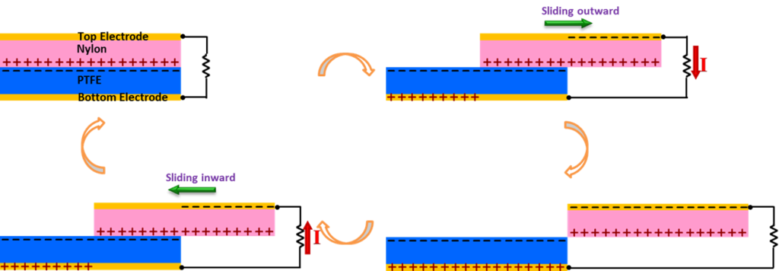
Triboelectric effect
Wireless Triboelectric Nanogenerator
Common Type of contact electrification
Charge seperation through seperation of adhesion
Polarity and strength of charge determined by involved materials
Crystallographic symmetry critical for tribo- and piezoelectric properties
Greatly enhanced by rubbing
[URL-1]

Slide 3
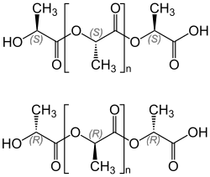
Triboelectric nanogenerators
Wireless Triboelectric Nanogenerator
Triboelectric nanogenerators (TENGs)
Maximize potential drop
Easy flow of power
Polylactic Acid (PLA)
Plant-derived
High degree of polarization
High electrical resistance
Graphene-PLA
Nanocomposite with conducting graphene
Capacity storage
Low electrical resistance
Teflon
High electronegativity
[URL-2]
Notes:
High polarisation due to 2 asymmetric carbon atoms with polar groups attached

Slide 4
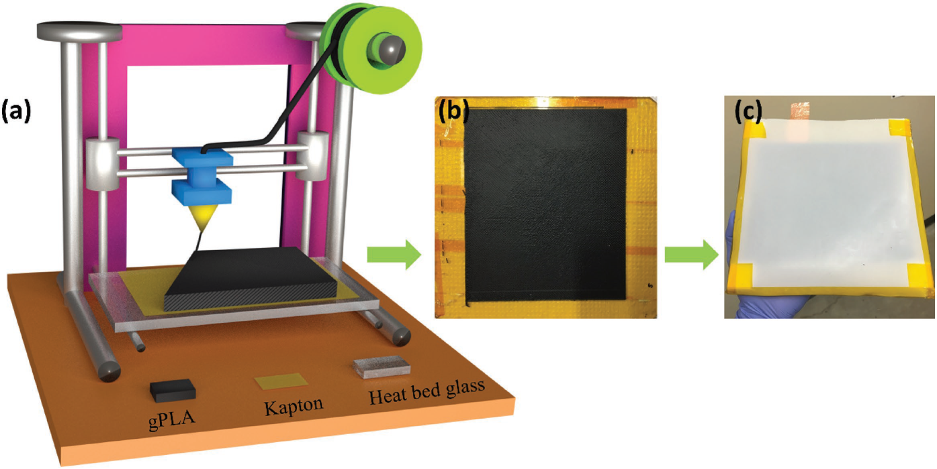
Structure
Wireless Triboelectric Nanogenerator
Printed gPLA as bottom electrode
Teflon sheet as top electrode
~1 mm air gap between electrodes
Copper spool as wireless transmitter
[Mallineni et al, 2018]

Slide 5
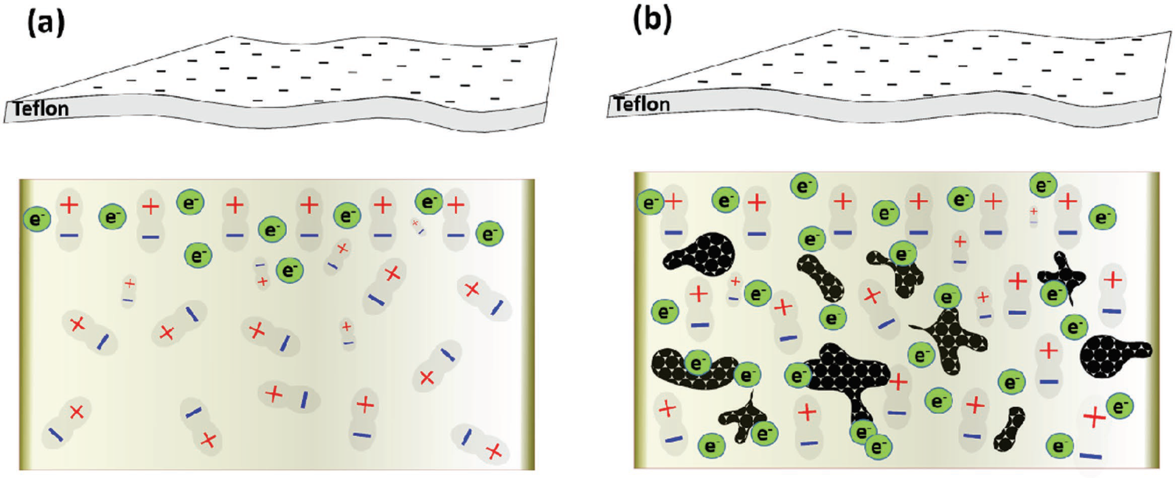
Structure
Wireless Triboelectric Nanogenerator
Increased polarisation of gPLA (b) compared to PLA (a)
Increased output voltage
Increased charge storage
[Mallineni et al, 2018]

Slide 6
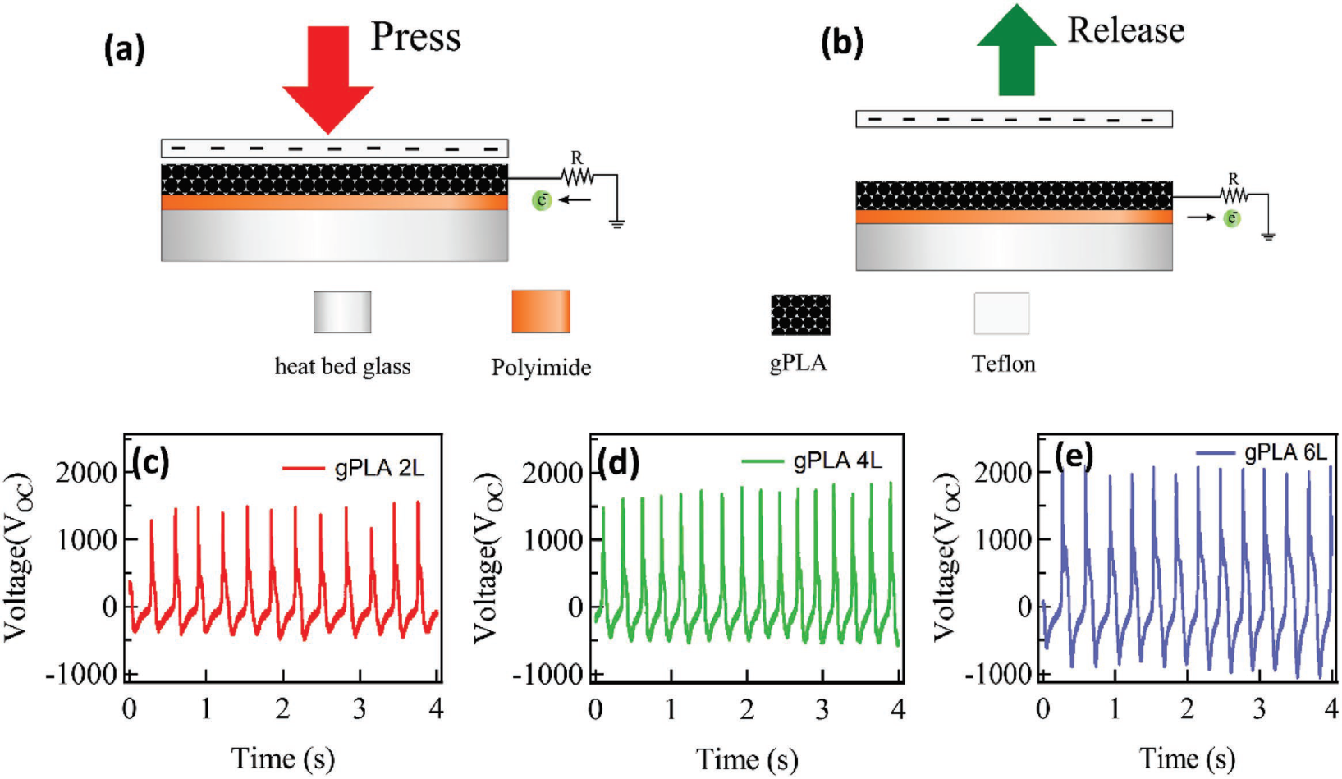
Results
Wireless Triboelectric Nanogenerator
Electrical Potential up to 2,4 kV
Up to 70 mW peak power
Scalably printed, mechanically robust
[Mallineni et al, 2018]

Slide 7
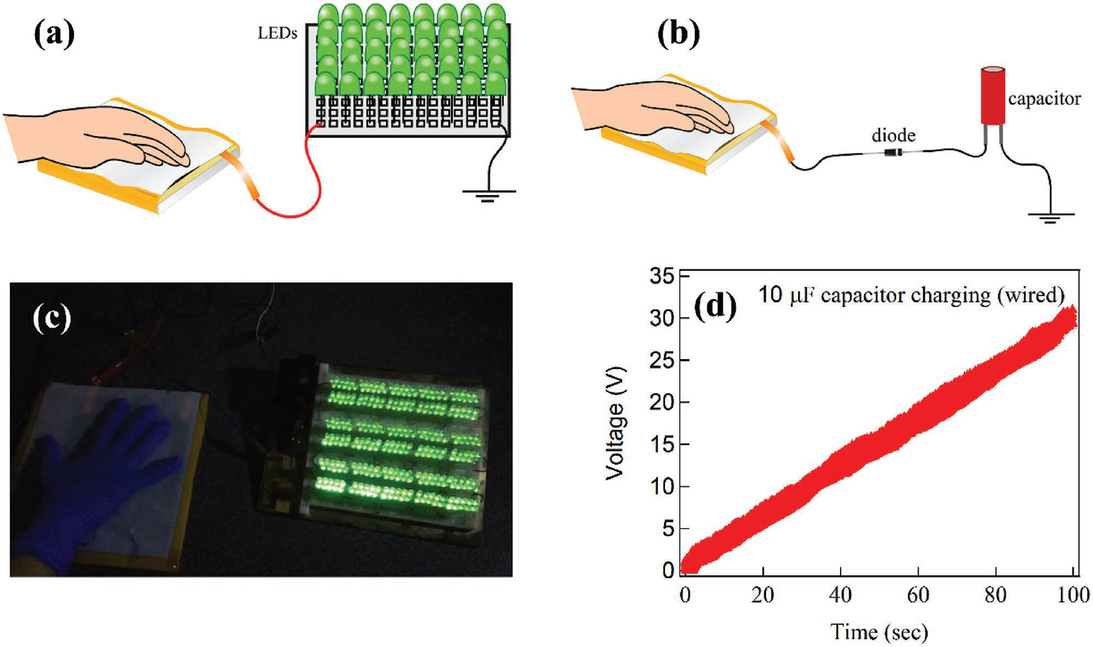
Results
Wireless Triboelectric Nanogenerator
[Mallineni et al, 2018]
Notes:
rectified

Slide 8
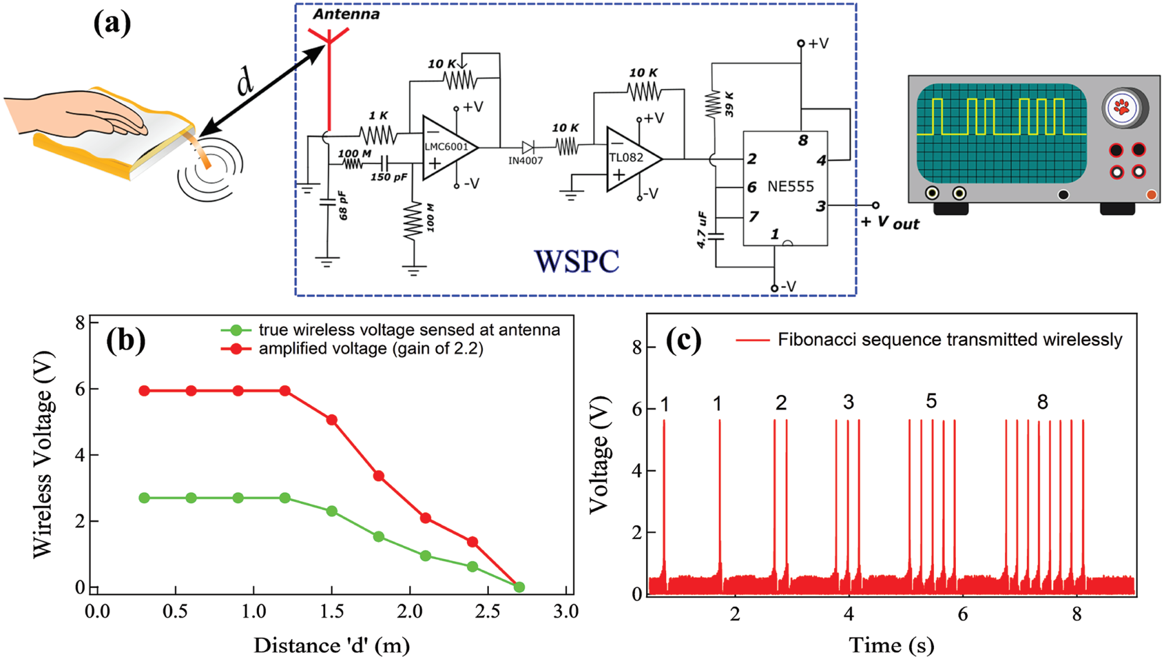
Results
Wireless Triboelectric Nanogenerator
Wireless signal transmission
Received via band-pass filter and amplified
[Mallineni et al, 2018]

Slide 9
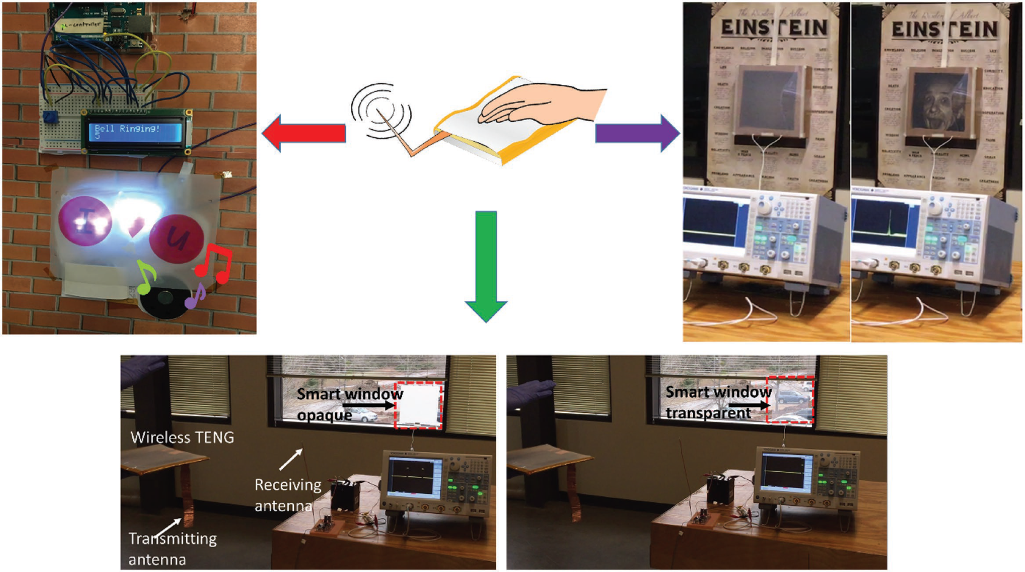
Applications
Wireless Triboelectric Nanogenerator
Selfpowered wireless controllers
Security Systems
Home automation, smart hardware
[Mallineni et al, 2018]

Slide 10
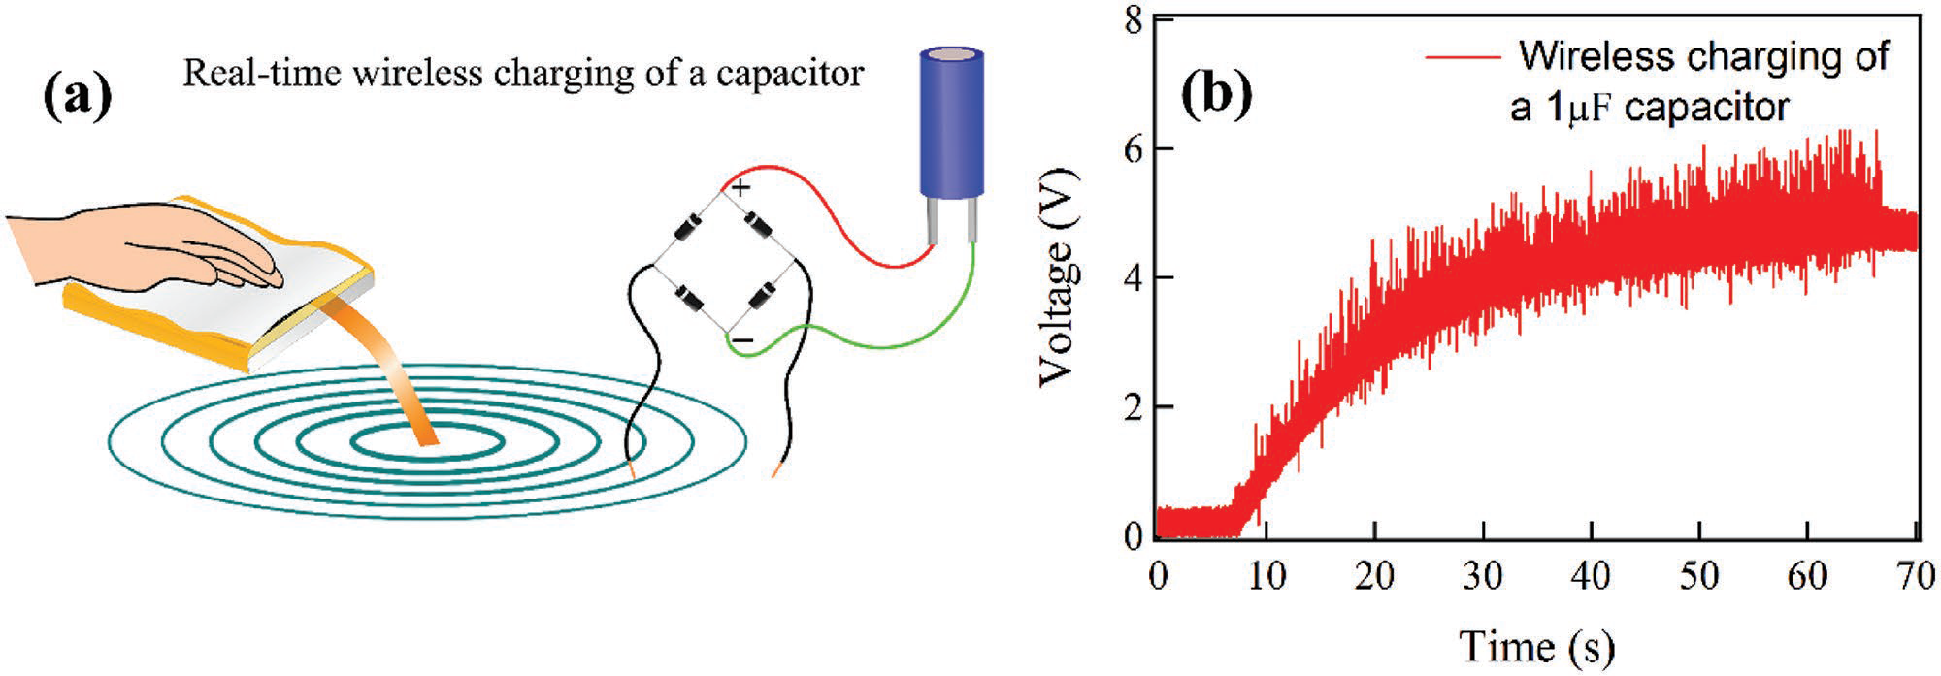
Applications
Wireless Triboelectric Nanogenerator
Wireless chargers
Wasted mechanical energy → electrical energy
~0.2 µW/min
Could be increased by further treatment of the electrodes
Large arrays for walkways/roads
[Mallineni et al, 2018]
Notes:
Full-wave rectifier

Slide 11
References
Mallineni, S., Dong Y. et al: A Wireless Triboelectric Nanogenerator, Advanced energy materials, Vol. 8, Iss. 10, 2017
[URL-1] https://en.wikipedia.org/wiki/Triboelectric_effect (20.06.2018)
[URL-2] https://de.wikipedia.org/wiki/Polylactide (20.06.2018)

Slide 12
Thank you for your attention!

